Slide 1
NeuroGaze in Virtual Reality: Assessing an EEG and Eye Tracking Interface Against Traditional Virtual Reality Input Devices
by
Wanyea Barbel
B.S, Computer Science, University of Central Florida, 2024
Notes:
test

Slide 2
ABSTRACT
Presenting NeuroGaze, a novel Virtual Reality (VR) interface that integrates electroencephalogram (EEG) and eye-tracking technologies to enhance user interaction within virtual environments (VEs). Diverging from traditional VR input devices, NeuroGaze allows users to select objects in a VE through gaze direction and cognitive intent, captured via EEG signals. The research assesses NeuroGaze's performance against conventional input devices such as VR controllers and eye gaze combined with hand gestures. The experiment, conducted with 20 participants, evaluates task completion time, accuracy, cognitive load through the NASA-TLX surveys and user preference through a Post Evaluation survey. Results indicate that while NeuroGaze presents a learning curve, evidenced by longer average task durations, it potentially offers a more accurate selection method with lower cognitive load, as suggested by its lower error rate and significant different in NASA-TLX scores for some subscales. This study highlights the viability of incorporating biometric inputs for more accessible and less demanding VR interactions. Future work aims to explore a multimodal EEG-Functional near infrared spectroscopy (fNIRS) approach, further develop machine learning models for EEG signal classification, and extend system capabilities to dynamic objects selection, highlighting the progressive direction for the use of Brain Computer Interfaces (BCI) in virtual environments.

Slide 3
CONTENTS
1 Introduction
2 Literature Review
3 Software & System Design - NeuroGaze
4 User Study
5 Future Work
6 Conclusion
7 References

Slide 4
INTRODUCTION

Slide 5
Introduction - Motivation
Earliest visions for VR systems – a young scholar with a dream for the future
The selection method problem
Disconnect with virtual environment
Cumbersome controls for selection
High physical demand for repeated motions
Notes:
Exigence for being a MRE in the first place → Randy Pausch Last lecture and work as an HCI researcher → Building virtual worlds in VR at CMU and expanding on his work
Interesting in selection specifically because how it enables any interaction in HCI
My personal experience with VR → discussions with friends about VR → controllers don’t feel as natural to use in a VR as they do in a non-VE (e.g. 3D stereoscopic display vs. 3D flat-screen displays)
Cumbersome and repeated → having to either keep arm up entire time to select (constant isotonic contractions) or repeated trigger/button pressing (isometric contractions)

Slide 6
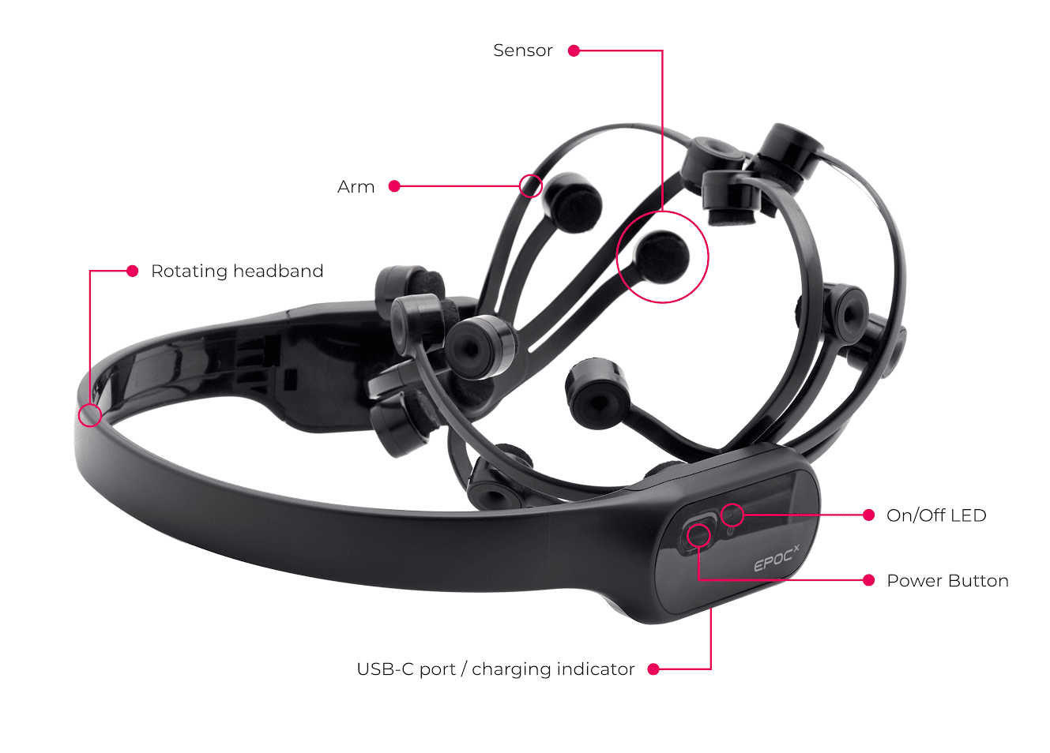
Introduction - Motivation
The BCI Solution
Industry research and Towards Brain-Computer Interfaces
Existing but limited research for BCI selection in VR
Eye-movement artifacts found in EEG stream to build artifact correction methods [21]
Using VR as a medium to simulate environments for recording EEG data
Emotiv EPOC X EEG headset
Notes:
Researcher and engineer at Universal Creative in the Advanced Technology Interactives department → reading works involving BCI and BCI book → Toward Brain-Computer Interfacing by Guido Dornhege.
Existing work in this space is scarce
Using eye gaze and EEG is done but a majority of the works I read during my literature review showed VR being used a medium for gathering EEG data under specific conditions (e.g. traumatic experiences, decision-points)
I want to help pave the road for BCI research specifically focused on interaction within VR interaction in the forefront!
I know I’m siting in a room of subject matter experts but bear with me, just want to make sure we’re on the same page

Slide 7
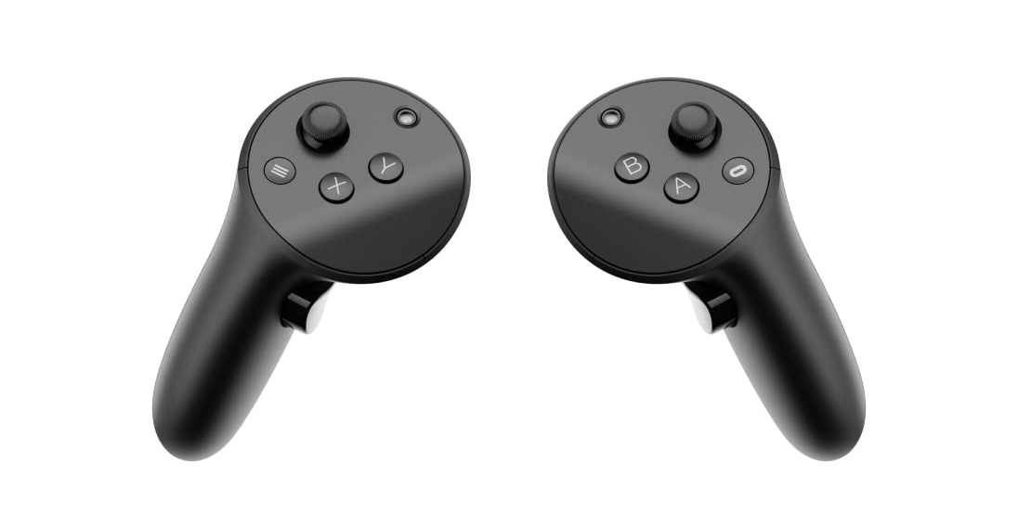
Introduction – Input Devices
VR Controllers
Handheld devices that allow users to interact with a VE
Enable users to navigate through menus and select objects
Point-and-click selection technique, ray casting metaphor
Precise control over selection and manipulation tasks, physically tiring when used for longer durations [17]
Meta Quest Pro VR Controllers
Notes:
I want to take a look at where we’ve come from, where we are, and where I believe we should be going
Starting with VR controllers
Point and click is a selection technique where you aim for interest and click for intent (seen early on with mouse movement and mouse click)
→ Precise control but can tiring over time, especially if repeated

Slide 8
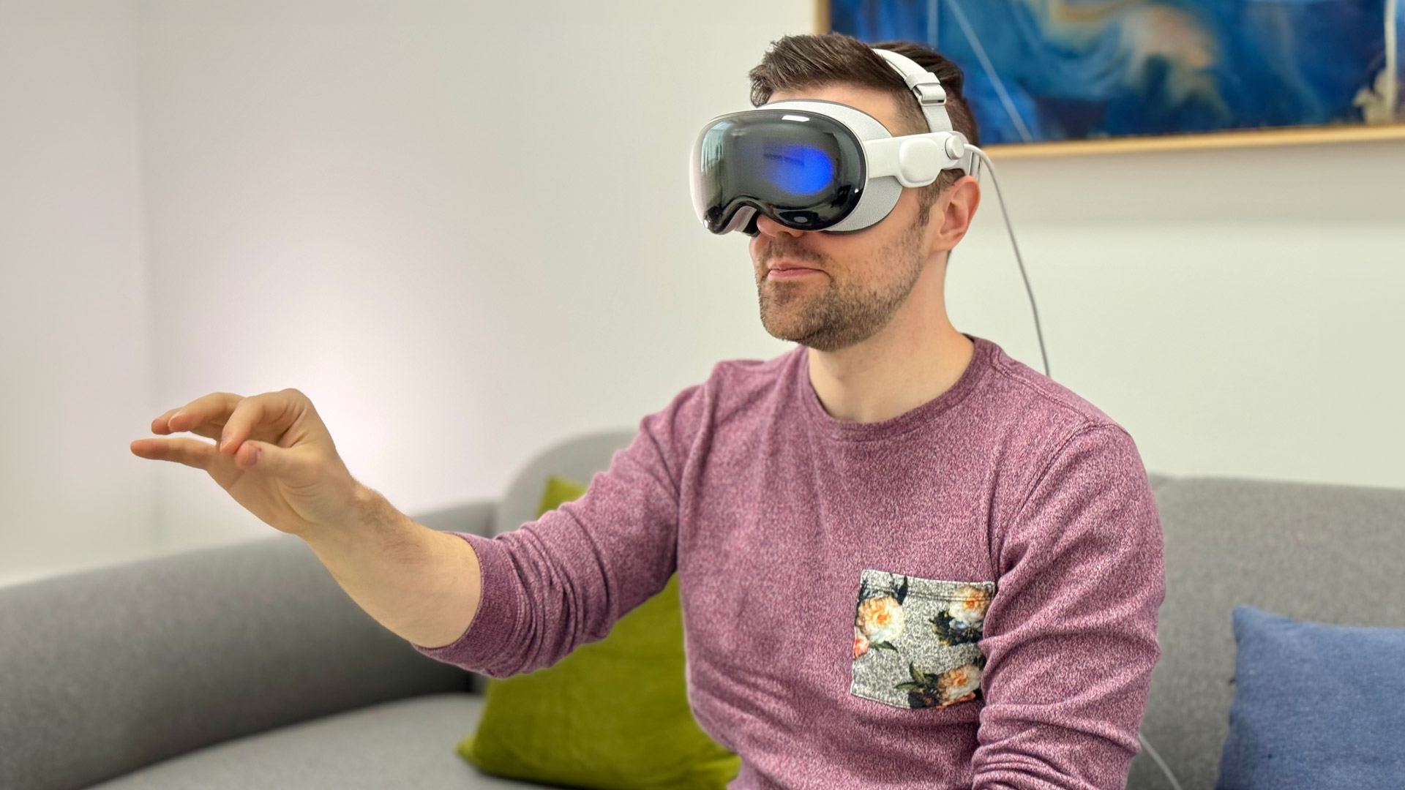
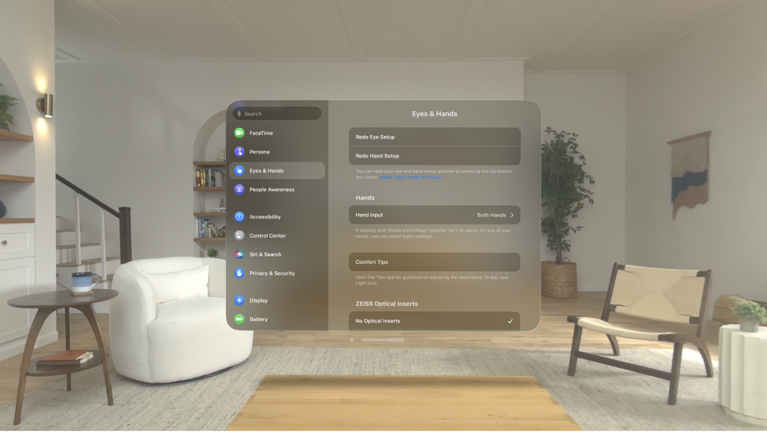
Introduction – Input Devices
Eye Gaze & Hand Tracking
Eye tracking to show interest, hand gesture for intent
IR cameras in Meta Quest Pro HMD
Hand gesture – pinching, specific hand movement to specify command [16]
Notes:
Hand tracking is used in a variety of headsets such as the Meta Quest 2
Eye tracking and hand tracking and eye tracking are supported by the Meta Quest Pro and Magic Leap II
Eye Gaze + Hand Tracking is main input technique for interaction with VE in new Apple Vision Pro

Slide 9
Introduction – Input Devices
NeuroGaze
Our developed input device
Non-invasive BCI, specifically using electroencephalogram (EEG)
IR cameras in Meta Quest Pro HMD for eye tracking (interest)
Emotiv EPOC X for EEG data stream (intent)
EmotivBCI program for preprocessing, segmentation, classification

Slide 10
LITERATURE REVIEW
Notes:
This section is the story of the ideation of the NueroGaze system.
Seeing how one unput device led to another until finally we arrive at what input device was used for evaluation
The design of the system was a journey through literature to min-max the pros and cons that come with designing a novel system

Slide 11
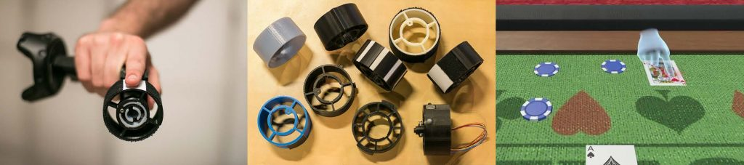
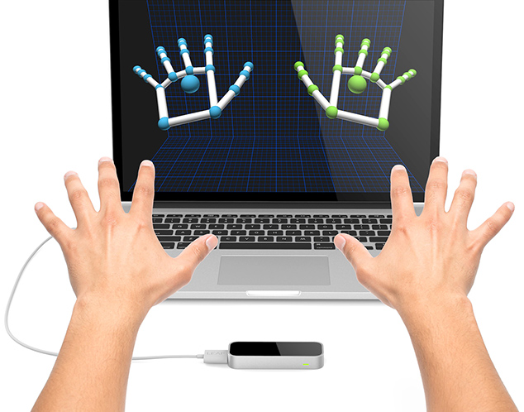
Literature Review – Input Modalities in VR: Physical Controllers
Whitmire et al. [23]
Unique handheld controller – Haptic Revolver
Haptic feedback with changeable wheels
Fahmi et al. [7]
VIVE VR controllers against Leap Motion Controllers (LMC) & Senso Gloves
User evaluated on Likert 7-point scale – VR controllers were very interactive and easy to learn
NeuroGaze challenge: develop intuitive and interactive input device
Whitmire, E. (2018). Haptic Revolver in VE with varying haptic wheels
Fahmi, F. (2020). LMC in observation area
Notes:
Haptic Revolver: actual wheel
Participants spin haptic wheel – able to feel variety of accurate haptic feedback depending on surface
Haptics weren’t able to be included in scope of thesis but should be mentioned for potential future works
LMC: infrared monochromic cameras that periodically take pictures
→ When users hand is detected, hand gestures are recorded → action is performed in VR
→ Although LMC isn’t a physical controllers, it shows us how users will prefer VR controllers if a non-physical controller isn’t as intuitive to use
Participant sentiments: “The use of controls on the system is vert interactive” “Controls are easy to learn”
Design NeuroGaze with intuitive/interactive input
Interactivity is only a fraction of usability → the device must be performant

Slide 12
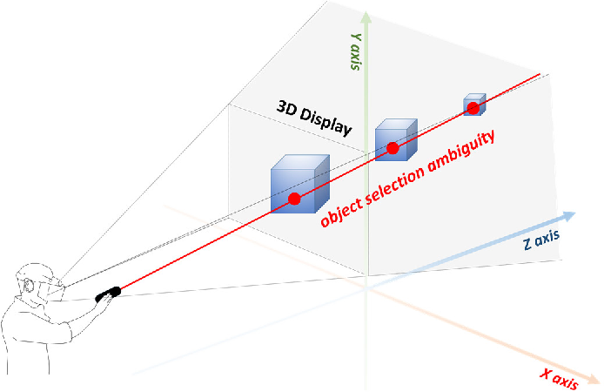
Literature Review – Input Modalities in VR: Physical Controllers
Luong et al. [18]
Evaluates interaction performance of VR controllers when compared to hand controllers (hand tracking)
Both utilizing used ray casting metaphor
Evaluated on task completion time and error
Common user sentiments: easier to reach objects farther away, tiring to use for long periods of time – began to hold controllers closer to body
NeuroGaze: no physical controllers of any time – too physically demanding, interested in ray casting metaphor
Ro, H. (2017). Traditional ray-casting interface for 3D displays use ambiguous object selection.
Notes:
We can observe this in the study conducted by Luong
Participants preferred VR controllers with ray cast because:
it was easier to interact with objects farther away
Easier to see what objects they were aiming at
Users started to feel more weight of controllers of time vs hands
Ergonomics metrics: consumed endurance / rapid upper limb assessment
→ Negative correlation between physical exertion and task accuracy
Although we never intended to use VR controllers with NeuroGaze, it was useful to see “what we’re up against” in order to alleviate some of the usability issues:
→ Physical exertion affect task accuracy

Slide 13
Literature Review – Input Modalities in VR: Eye Gaze
Eye Gaze → eye tracking to measure direction of user’s eye with infrared cameras
Four Basic Types of Eye Movements
Saccades: rapid movements towards stimuli
Smooth Pursuit: slower tracking movements
Vergence: stimuli at different distances from observer
Vestibulo-ocular: stable vision while moving head
Piumsomboon et al. [23]
Duo-Reticles: eye-gaze + inertial reticle
Radial Pursuit: slowly expand dense space
Nod and Roll: eye gaze locks frame + head movement provides intent
Find matching pairs (TCT/Error)
7-point Likert Scale Usability Survey
Notes:
Eye tracking achieved with infrared cameras that illuminate the eye by refracting light off the cornea and the retina to create distinct patterns (glints)
Glint detection algorithms to calculate the gaze point and achieve high speed eye tracking capabilities (e.g. RemoteEye software)
Saccades (suh-kaydz): rapid, often ballistic movement towards visual stimuli – changing the point of fixation (amplitude can be as small as reading text all the way to looking around a room)\
Smooth pursuit: movements involving closely tracking a moving object. Unlike saccades, speed is slower and matches speed of moving target (e.g. looking at a ball in motion)
Vergence: adjusting angle of the eye to ensure image falls on identical portions of both retinas (e.g. focusing on objects of two different distances)
Vestibulo-ocular reflex: Involuntary movement that stabilizes vision during head movement (e.g. turn your head to the left quickly, your eyes will move to the right with the same speed, allowing you to keep focus on stationary object.
Piumsomboon:
DR: eye-gaze + one reticle (saccades)
RP: smooth pursuit
N & R: vestibulo-ocular relex
Evaluation Results: Wilcoxon signed rank test to determine significance → Data showed significance for SUS, favoring DR (specifically lower fatigue)
No significance between input devices for performance data

Slide 14
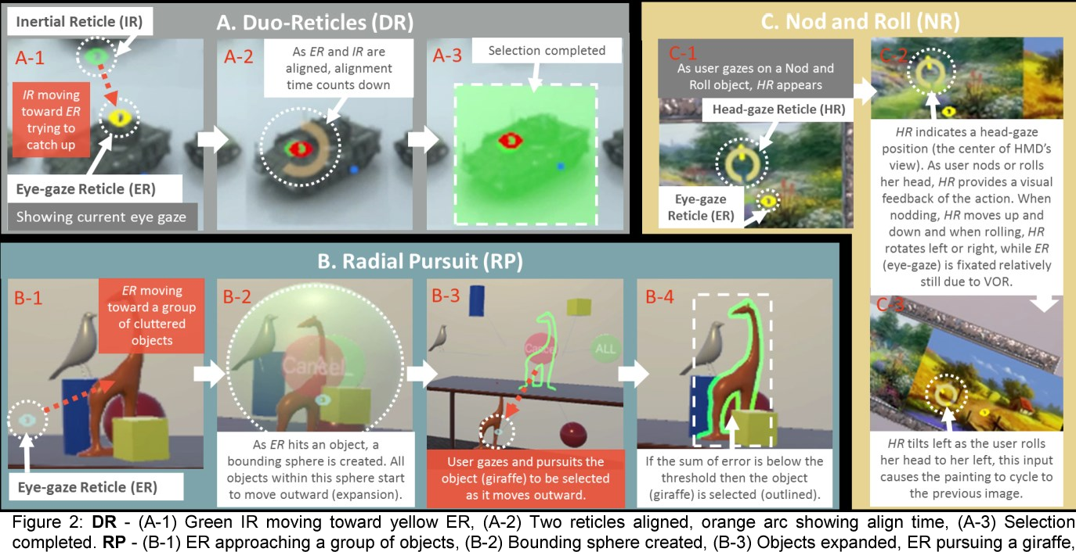
Literature Review – Input Modalities in VR: Eye Gaze
Piumsomboon, T. (2017). Visualized: Duo-Reticle, Radial Pursuit, and Nod and Roll

Slide 15
Literature Review – Input Modalities in VR: Eye Gaze
Francisco et al. [17]
Point-and-click: VR controllers accuracy compared to VR controller + eye-gaze (ray casting metaphor)
Eye gaze + VR controllers performed on par with VR controllers alone
NASA-TLX: eye gaze yielded less cognitive load (physical demand, effort)
SUS: participants preferred the combination over VR controllers alone
NeuroGaze: use eye gaze (with ray metaphor) with what non-invasive BCI?
Notes:
Study interested us because by using a part of Duo-Reticles (taking advantage of how quickly the eye can update to new stationary target) might benefit the NueroGaze system
Now we were interested in how this technique would compare to our previously mentioned “competitor”: VR controllers
Francisco:
Not independent of controllers but uses saccade-based technique from DR for interest and VR controllers for intent for selection task: we can at least see if eyes can provide interest more accurate/intuitiveness/efficiently than controllers alone
Low statistical significance between completion times between the input devices
NASA-TLX: Participants felt more physical demand and effort was required than eye gaze
Based on literature in this space, eye gaze was proving to be a solution to our problem:
Less cognitive load than VR controllers, performing on par at least with TCT, able to host eye casting metaphor

Slide 16
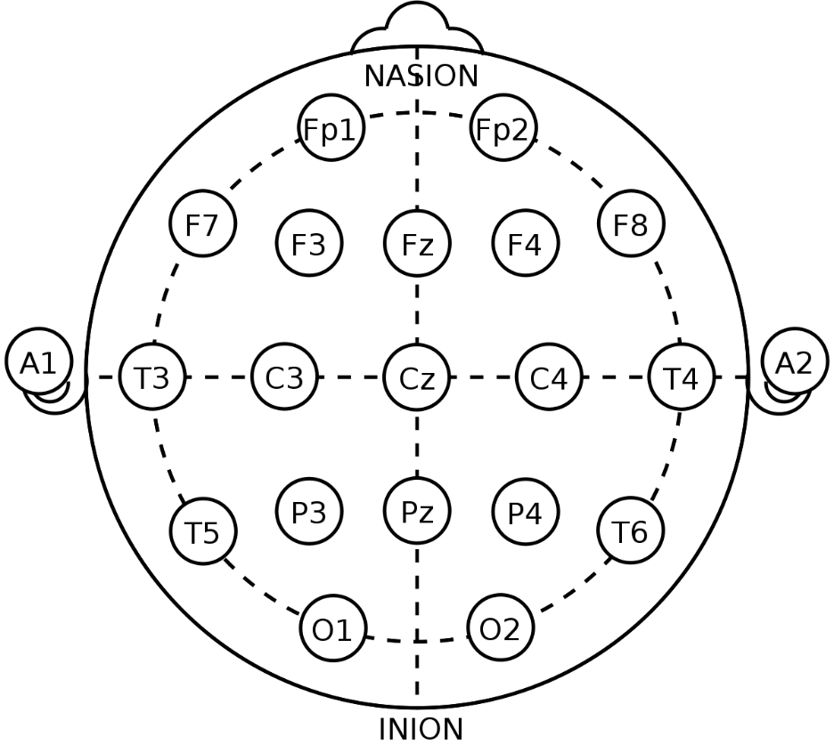
Literature Review – Input Modalities in VR: Brain Computer Interfaces
Neural signals (e.g. EEG) translated into actionable mental commands
International 10-20 system – NeuroGaze is compliant
Larsen et al. [15]
SVVEP-Speller
Look at letters of interest with flickering to train ML model on blink denoising
Introduced us to the blinking noise problem
Electrode locations of International 10-20 system for EEG recording
Notes:
Neural signals: fNIRS – functional near-infrared spectroscopy (oxygenated/deoxygenated hemoglobin concentrations), fMRI: functional magnetic resonance imaging: changes in blood flow that occurs in brain activity
All fascinating, but out of scope for this Thesis → Future Work
10-20 International System
Why? To build upon other researchers work with as little confounding variables as possible (standardize!)
Nasion (depressed area between eyes)
Inion (crest of the back of the skull)
10-20 refers to 10% to 20% of spacing between each adjacent electrode (starting from ear to ear)
Electrode labeling:
→ Starting letter used to identify lobe or area: C – central, O – occipital, P –pariental, T – temporal, Fp – prefrontal
Numbers → even right side, odd left side
Example: Fp1 is left prefronal cortex
Other systems (10/10 and 10/5 but not international recognized
Larsen:
→

Slide 17
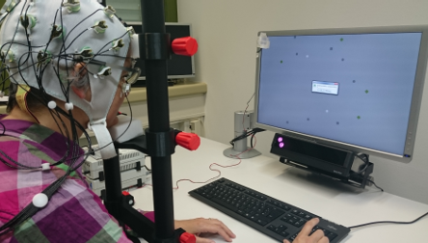
Literature Review – Input Modalities in VR: Brain Computer Interfaces
Putze et al. [22]
EEG+GAZE
Trained ML classifier for intent only when a user’s eyes slowly moves towards an object
Very limited false positives, more accurate classification for event-based evaluation scenes. [25]
In the end, NeuroGaze doesn’t use a model we developed… but it could!
Putze, F. (2016). Apparatus for recording EEG ad eye tracking data
Notes:
Electrode placement: (10/20-System) CZ, FP2, F3, FZ, F4, FT7, C3, FP1, C4, FT8, P3, PZ, P4, PO7, PO8, OZ, sampling rate 500Hz
Continued work in spatio-temporal localization of task-relevant events: how the brain recognizes/processes timing and location of stimuli in relation to task at hand (e.g. moment you notice stop sign while driving)
ML classifier was trained on saccade-smooth pursuit EEG data only. Taking advantage of the eyes’ natural ability to look in areas of interest, genius!
As you can see from this lit review, we believed it was possible to accurate classify intent with EEG and use that with the existing HCI methods to create something new!
You should also notice how close these works skid the line of creating a new technique without actually doing so for VE
Due to constraints, it made more sense to use Emotiv’s pretrained model due to the thousands of recordings its trained on, not feasible for us to take on for the scope of this thesis.
Now at this point we’ve

Slide 18
Literature Review – Recap
VR Controllers
Performant for TCT
Produce high Physical Demand
Empowered by ray casting metaphor
Eye Gaze
Duo-Reticle: power of saccade
Lower Physical Demand the VRC
Empowered by ray casting metaphor
Comparable TCT – no significance
Brain Computer Interfaces
Must be 10-20 International Compliant
Classify and address noise artifacts when possible
ML classifiers are developed enough to yield segment intent
NeuroGaze lends itself to all these interfaces
Notes:
NueroGaze builds on all of these, the design is feasible but how will it perform?
We believe it will have slower TCT because of lethargic classifiers but yield less error
Users will enjoy it because it will use saccade which is actively happening anyways paired with the performant eye casting metaphor to show intent before selection
Lower cognitive load (Physical, Effort, possible temporal from eye gaze, we worry about mental though)

Slide 19
SOFTWARE & SYSTEM DESIGN - NEUROGAZE

Slide 20
Software & System Design: System Overview

Slide 21
Software & System Design: EEG Hardware

Slide 22
Software & System Design: EEG Hardware

Slide 23
Software & System Design: EEG Hardware

Slide 24
Software & System Design: EEG Software

Slide 25
Software & System Design: EEG Software

Slide 26
Software & System Design: EEG Software

Slide 27
Software & System Design: NeuroGaze Design Architecture

Slide 28
Software & System Design: NeuroGaze Design Architecture

Slide 29
Software & System Design: NeuroGaze Design Architecture

Slide 30
Software & System Design: NeuroGaze Design Architecture

Slide 31
Software & System Design: NeuroGaze Design Architecture

Slide 32
Software & System Design: NeuroGaze Design Architecture

Slide 33
Software & System Design: NeuroGaze Design Architecture

Slide 34
USER STUDY

Slide 35
User Study: Experimental Design

Slide 36
User Study: Experimental Design

Slide 37
User Study: Experimental Design

Slide 38
User Study: Results

Slide 39
User Study: Results

Slide 40
User Study: Results

Slide 41
User Study: Results

Slide 42
User Study: Discussion

Slide 43
User Study: Discussion

Slide 44
FUTURE WORK

Slide 45
Future Work: Addressing Ergonomics & Limitations
Dwdw
Dwdwd
Wdwddw
Dwdwdw
Universal only pays me so much…

Slide 46
Future Work: Other Non-invasive BCIs

Slide 47
Future Work: Experimental Design Improvements

Slide 48
CONCLUSION

Slide 49
Conclusion

Slide 50
INSERTING A NEW SLIDE
To insert a new slide, go to the “Home” Tab and click on the drop-down arrow next to “New Slide.” From there, you may select a slide layout from pre-made templates.
These will give you a starting point for your presentation, but you may need to make slight modifications — such as font size and text-box placement — based on the length of your content.

Slide 51
FEATURES
FOOTER AND PAGE NUMBERS Slides with white backgrounds include a footer with the name of the university and page numbers that update automatically.
GUIDES To assist with layouts, all slides include guidelines with suggested margins. Guides can be turned on and off under “View,” and then “Guides.”

Slide 52
ADJUSTING TEXT
TYPEFACES This template uses the typeface Gotham. A limited number of discounted Gotham font licenses are available for purchase by UCF communicators only. Get Gotham here. Alternate suggested typefaces are Helvetica, Verdana, or Arial.
EXTRA STYLING A couple of ways to add emphasis to a word or phrase within your content are to add bold styling or adding a highlight in “bright gold.”
FONT SIZES AND LINE SPACING These can be adjusted manually to fit your content. The default font size for slide titles is 24pt. The default font sizes for slide text are 18pt and 14pt. The default line spacing is 1.5 with 10pt set for the “Space After” in the “Line Spacing Options” dialog box.
CONTENT FRAMES The size and placement of your content frames may be adjusted to fit you content.
By default, all new text and content frames will include bulleted lists. If you would like to remove these, go to the “Home” tab, and select “None” in the “Bullets” drop-down

Slide 53
PICTURE PLACEHOLDERS
To add a photo, click on the icon in the picture placeholder area
If you are inserting an image with a transparent background — such as a .png file — you can remove the light grey background in the picture placeholder. Select the picture frame, go to the ”Home” tab, select “Shape Fill.” Select “No Fill” from the drop-down menu.
You may additional photos to each slide manually

Slide 54
“We remain committed to unleashing potential in people, organizations, ideas, and the communities we serve. That charge inspires us and illuminates fantastic possibilities ahead.”
Dr. Alexander N. Cartwright
UCF President

Slide 55
We remain committed to unleashing potential in people, organizations, ideas, and the communities we serve. That charge inspires us and illuminates fantastic possibilities ahead.”
Dr. Alexander N. Cartwright
UCF President

Slide 56


DESIGN ELEMENTS
Short line used underneath slide titles (UCF yellow)
By default, decorative items such as the lines underneath the slide titles, the large quotation marks, and vertical- and horizontal-divider lines are built into the designs of the Slide Masters.
If you need to create a custom layout, here are a few of those elements that can be copied and pasted into your own presentation.
Longer line used on Title, Divider and Quotation Slides (UCF yellow or white)
Images of the large opening quotation mark used on Quotation Slides (.png files in UCF yellow and white)
To the left: Vertical divider line to place between columns of content (light grey)

Slide 57
REFERNCES
[1] Agarwal, M., & Sivakumar, R. (2019). Blink: A Fully Automated Unsupervised Algorithm for Eye-Blink Detection in EEG Signals. In 2019 57th Annual Allerton Conference on Communication, Control, and Computing (Allerton) (pp. 1113-1121). Monticello, IL, USA: IEEE. https://doi.org/10.1109/ALLERTON.2019.8919795
[2] Argelaguet, F., & Andujar, C. (2013). A Survey of 3D Object Selection Techniques for Virtual Envi-ronments. Computers & Graphics, 37(3), 121-136. https://doi.org/10.1016/j.cag.2012.12.003
[3] Baceviciute, S., Lucas, G., Terkildsen, T., & Makransky, G. (2022). Investigating the redundancy prin-ciple in immersive virtual reality environments: An eye-tracking and EEG study. Journal of Com-puter Assisted Learning, 38(1), 120-136. https://doi.org/10.1111/jcal.12595
[4] Blattgerste, J., Renner, P., & Pfeiffer, T. (2018). Advantages of eye-gaze over head-gaze-based selec-tion in virtual and augmented reality under varying field of views. In Proceedings of the Work-shop on Communication by Gaze Interaction. https://doi.org/10.1145/3206343.3206349
[5] Clark, L. D., Bhagat, A. B., & Riggs, S. L. (2020). Extending Fitts’ law in three-dimensional virtual environments with current low-cost virtual reality technology. International Journal of Human-Computer Studies, 139, 102413. https://doi.org/10.1016/j.ijhcs.2020.102413
[6] Decety, J. (1996). The neurophysiological basis of motor imagery. Behavioural Brain Research, 77(1-2), 45-52. https://doi.org/10.1016/0166-4328(95)00225-1
[7] Fakhruzzaman, M. N., Riksakomara, E., & Suryotrisongko, H. (2015). EEG Wave Identification in Human Brain with Emotiv EPOC for Motor Imagery. Procedia Computer Science, 72, 269–276. https://doi.org/10.1016/j.procs.2015.12.140
[8] Fahmi, F., Tanjung, K., Nainggolan, F., Siregar, B., Mubarakah, N., & Zarlis, M. (2020). Comparison study of user experience between virtual reality controllers leap motion controllers and senso glove for anatomy learning systems in a virtual reality environment. IOP Conference Series: Materials Science and Engineering, 851(1), 012024. https://doi.org/10.1088/1757-899X/851/1/012024
[9] Fitts, P. M., & Seeger, C. M. (1953). S-R compatibility: Spatial characteristics of stimulus and response codes. Journal of Experimental Psychology, 46(3), 199-210. https://doi.org/10.1037/h0062827
[10] Hosp, B., Eivazi, S., Maurer, M., Fuhl, W., Geisler, D., & Kasneci, E. (2020). RemoteEye: An open-source high-speed remote eye tracker. Behavior Research Methods, 52, 1387–1401. https://doi.org/10.3758/s13428-019-01305-2
[11] Imaoka, Y., Flury, A., & de Bruin, E. D. (2020). Assessing Saccadic Eye Movements With Head-Mounted Display Virtual Reality Technology. Frontiers in Psychiatry, 11, 572938. https://doi.org/10.3389/fpsyt.2020.572938
[12] Jurcak, V., Tsuzuki, D., & Dan, I. (2007). 10/20, 10/10, and 10/5 systems revisited: Their valid-ity as relative head-surface-based positioning systems. NeuroImage, 34(4), 1600–1611. https://doi.org/10.1016/j.neuroimage.2006.09.024
[13] Khan, G. M. (2015). A new electrode placement method for obtaining 12-lead ECGs. Open Heart, 2(1), e000226. https://doi.org/10.1136/openhrt-2014-000226
[14] Khazi, M., Kumar, A., & J, V. M. (2012). Analysis of EEG using 10:20 electrode system. Inter-national Journal of Innovative Research in Science, Engineering and Technology, 1(2).

Slide 58
REFERNCES
[15] Khundam, C., Vorachart, V., Preeyawongsakul, P., Hosap, W., & Noël, F. (2021). A Compara-tive Study of Interaction Time and Usability of Using Controllers and Hand Tracking in Vir-tual Reality Training. Informatics, 8(3), 60. https://doi.org/10.3390/informatics8030060
[16] LaViola Jr., J. J., Kruijff, E., Bowman, D. A., McMahan, R. P., & Poupyrev, I. (2017). 3D User Interfaces: Theory and Practice. Addison-Wesley Professional.
[17] Larsen, O. F. P., Tresselt, W. G., Lorenz, E. A., Holt, T., Sandstrak, G., Hansen, T. I., Su, X., & Holt, A. (2024). A method for synchronized use of EEG and eye tracking in fully immersive VR. Frontiers in Human Neuroscience, 18, 1347974. https://doi.org/10.3389/fnhum.2024.1347974
[18] Lin, W., Du, L., Harris-Adamson, C., Barr, A., & Rempel, D. (2017). Design of hand gestures for manipulating objects in virtual reality. In M. Kurosu (Ed.), Human-Computer Interaction. Theories, Methods, and Human Issues: 19th International Conference, HCI Interna-tional 2017, Vancouver, BC, Canada, July 9-14, 2017, Proceedings, Part I (pp. 584–592). Springer International Publishing. https://doi.org/10.1007/978-3-319-58071-5_44
[19] Lopez Luro, F., & Sundstedt, V. (2019). A comparative study of eye tracking and hand control-ler for aiming tasks in virtual reality. In ETRA '19: Proceedings of the 11th ACM Symposium on Eye Tracking Research & Applications (Article No. 68, pp. 1–9). ACM. https://doi.org/10.1145/3317956.3318153
[20] Luong, T., Cheng, Y. F., Mobus, M., Fender, A., & Holz, C. (2023). Controllers or Bare Hands? A Controlled Evaluation of Input Techniques on Interaction Performance and Exertion in Virtual Reality. IEEE Transactions on Visualization and Computer Graphics, 29(11), 4633-4642.
[21] Oviatt, S. (1999). Mutual disambiguation of recognition errors in a multimodal architecture. In CHI '99 - Proceedings of the SIGCHI conference on Human Factors in Computing Systems (pp. 576-583). Association for Computing Machinery (ACM). https://doi.org/10.1145/302979.303163
[22] Perret, J., & Vander Poorten, E. B. (2018). Touching Virtual Reality: A Review of Haptic Gloves. Conference Paper, June 2018. Haption GmbH, Aachen, Germany; Department of Mechanical Engineering, KU Leuven, Belgium. Retrieved from https://www.researchgate.net/publication/324562855
[23] Piumsomboon, T., Lee, G. A., Lindeman, R. W., & Billinghurst, M. (2017). Exploring natural eye-gaze-based interaction for immersive virtual reality. In Proceedings of the 2017 IEEE Symposium on 3D User Interfaces (3DUI) (pp. 1-10). IEEE. https://doi.org/10.1109/3DUI.2017.7893315
[24] Plöchl, M., Ossandón, J. P., & König, P. (2012). Combining EEG and eye tracking: Identification, characterization, and correction of eye movement artifacts in electroencephalographic data. Frontiers in Human Neuroscience, 6, Article 278. https://doi.org/10.3389/fnhum.2012.00278
[25] Putze, F., Popp, J., Hild, J., Beyerer, J., & Schultz, T. (2016). Intervention-Free Selection using EEG and Eye Tracking. In Proceedings of the 18th ACM International Conference on Multimodal Interaction (ICMI '16), Tokyo, Japan. ACM. https://doi.org/10.1145/2993148.2993199
[26] Rayner, K. (1998). Eye movements in reading and information processing: 20 years of research. Psychological Bulletin, 124(3), 372–422. https://doi.org/10.1037/0033-2909.124.3.372
[27] Rosenfeld, R., D. Olsen, and A. Rudnicky (2001). “Universal Speech Interface.” Interactions 8(6): 33-44.

Slide 59
REFERNCES
[28] Whitmire, E. (2018). High-Fidelity Interaction for Virtual and Augmented Reality. In 2018 IEEE Conference on Virtual Reality and 3D User Interfaces (pp. 796-798). Reutlingen, Germany: IEEE. https://doi.org/10.1109/VR.2018.8446520
[29] Wolpaw, J. R., Birbaumer, N., McFarland, D. J., Pfurtscheller, G., & Vaughan, T. M. (2002). Brain-computer interfaces for communication and control. Clinical Neurophysiology, 113(6), 767–791. https://doi.org/10.1016/S1388-2457(02)00057-3
[30] Zander, T. O., Gärtner, M., Kothe, C., & Vilimek, R. (2011). Combining Eye Gaze Input With a Brain–Computer Interface for Touchless Human–Computer Interaction. International Journal of Human-Computer Interaction, 27(1), 38-51. https://doi.org/10.1080/10447318.2011.535752
[31] Zhai, S. (1995). “Human Performance in Six Degree of Freedom Input Control.” PhD Dissertation, Department of Computer Science, University of Toronto

